Slide 1
DEPARTMENT OF PHYSICS
SRM INSTITUTE OF SCIENCE AND TECHNOLOGY
18PY103J – Physics: Semiconductor Physics
Module-I, Lecture-14
Fermi-Dirac Distribution Function f(E) and Influence of donors in semiconductors
18PYB101J Module-I Lecture-14
18PYB103J Module-I Lecture-1

Slide 2
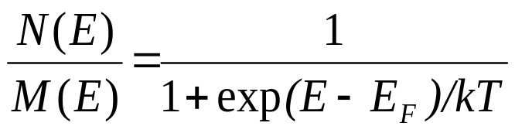
Fermi-Dirac Distribution Function f(E)
The free electron gas in a solid obeys Fermi-Dirac statistics.
Suppose in an assemblage of fermions, there are M(E) allowed quantum
states in an energy range between E and E+dE and N(E) is the number
of particles in the same range.
The Fermi-Dirac distribution function is defined as,
N(E) / M(E) is the fraction of the possible quantum states which are occupied.
18PYB101J Module-I Lecture-14

Slide 3
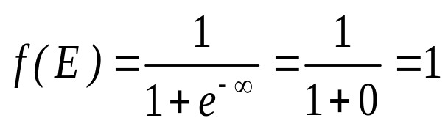
Fermi-Dirac Distribution Function f(E)
The distribution of electrons among the levels is described by function f (E), probability of an electron occupying an energy level ‘E’.
If the level is certainly empty, then f(E) = 0. Generally the f(E) has a value in between zero and unity.
When E< E_{F} (i.e.,) for energy levels lying below E_{F}, (E –E_{F}) is a negative quantity and hence,
That means all the levels below E_{F} are occupied by the electrons.
18PYB101J Module-I Lecture-14

Slide 4
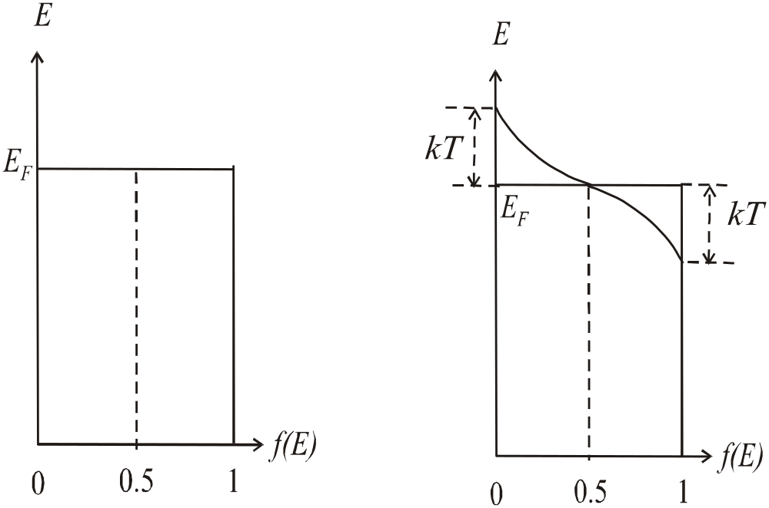
Fermi-Dirac Distribution Function f(E)
Fermi Dirac distribution function at different temperatures
18PYB101J Module-I Lecture-14

Slide 5
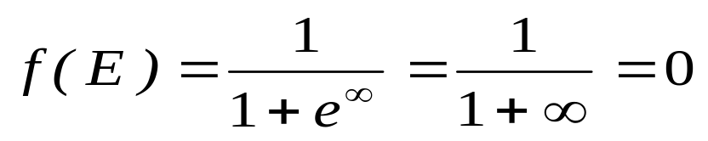
Fermi-Dirac Distribution Function f(E)
When E > E_{F} (i.e.) for energy levels lying above E_{F,} (E – E_{F}) is a positive quantity
This equation indicates all the levels above E_{F} are vacant.
At absolute zero, all levels below E_{F} are completely filled and all levels above E_{F} are completely empty.
This level, which divides the filled and vacant states, is known as the Fermi energy level.
18PYB101J Module-I Lecture-14

Slide 6
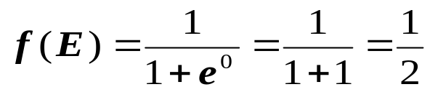
Fermi-Dirac Distribution Function f(E)
When E = E_{F} ,
at all temperatures
The probability of finding an electron with energy equal to the Fermi energy in a metal is ½ at any temperature.
At T = 0 K all the energy level upto E_{F} are occupied and all the energy levels above E_{F} are empty .
When T > 0 K, some levels above E_{F} are partially filled while some levels below E_{F} are partially empty.
18PYB101J Module-I Lecture-14

Slide 7
Influence of donors in semiconductors
  The group V element has five valence electrons. Four of these will contribute to the covalent bonding with the silicon atoms, leaving the fifth more loosely hound to the phosphorus atom. the fifth valence electron as a donor electron.
  The phosphorus atom without the donor electron is positively charged.
  At very low temperatures, the donor electron is bound to the phosphorus atom.
  However By intuition, it should seem clear that the energy required to elevate the donor electron into the conduction band is considerably less than that for the electrons involved in the covalent bonding.
18PYB101J Module-I Lecture-14

Slide 8
Influence of donors in semiconductors
  If a small amount of energy, such as thermal energy. is added to the donor electron, it can be elevated into the conduction band, leaving behind a positively charge phosphorus ion.
  The electron in the conduction band can now move through the crystal generating a current, while the positively charged ion is fixed in the crystal.
  This type of impurity atom donates an electron to the conduction band and so is called a donor impurity atom.
  The donor impurity atoms add electrons to the conduction band without creating holes in the valence band. The resulting material is referred to as an n-type semiconductor (n for the negatively charged electron)
18PYB101J Module-I Lecture-14

Slide 9
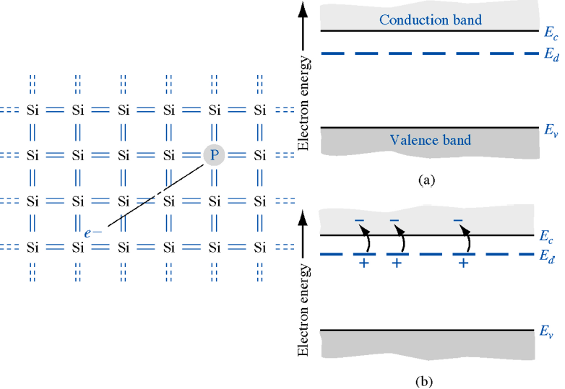
Influence of donors in semiconductors
  Figure shows the energy-hand diagram that we would expect. The energy level, Ed, is the energy state of the donor electron.
18PYB101J Module-I Lecture-14

